Slide 1
Mainframe Modernization
Bob Ellsworth
Director, WW Enterprise Modernization
& Azure HiPo Partner Program

Slide 2


Modernization/Migration Drivers
FLEXIBILITY & CHOICE
Deployment options:
Cloud (Public/Private/Hybrid)
ISV solutions
AGILITY
Improve time to market
Responsive to Business
TCO
Significant savings over Oracle, DB2, IBM Mainframe and VMware
SKILLS
Difficult to find skills in legacy
platforms

Slide 3


Modernization Paths Mainframe to Azure
EXISTING ENVIRONMENT
RETIRE
Redundant or Low-Value
Reduce costs
MODERN ENVIRONMENT
Discard Applications
CUSTOMER
RETAIN
Platform Capability Selling
Grow business incrementally
Cloud OS
Wrap Existing Systems
Replicate DATA to SQL for BI
Applications: Cobol, JAVA, PL/1, Fortran, Assembler, Natural
WINDOWS AZURE
SERVICE PROVIDER
Transaction Server: CICS, IMS
REPLACE
Solution Area Selling
Move IT focus to value-add areas
No Added Value
Replace with Packaged Offering
Data Insights
Databases: DB2, VSAM, IMS, Adabas, IDMS
Workloads: Dev & Test
Application meets needs but is expensive to run
Move to Windows/SQL without Change
RE-HOST
Improve operational efficiency
Increase agility and reduce costs
VMs: Linux
Modern Biz Apps
Custom App Development
Improve market differentiation
RE-ENVISION
No Application in Market
Need to Differentiate through Custom Development
BUSINESS INITIATIVES DRIVE MODERNIZATION
Notes:
Time: 3 minutes
Facilitator: Some of the business related initiatives to look for that can help drive modernization.

Slide 4
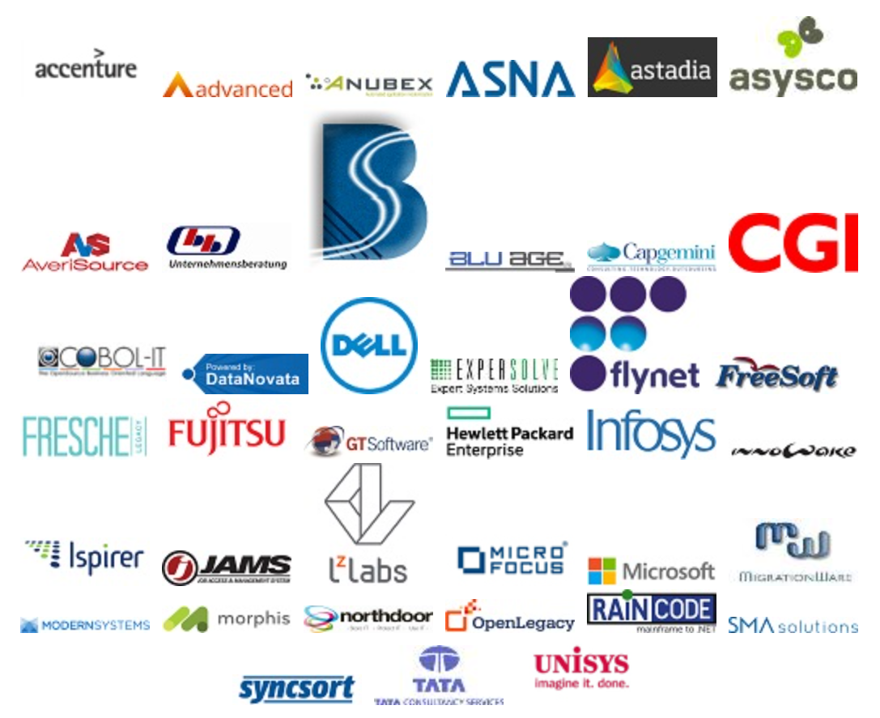
Mainframe Modernization Partners
Mainframe Modernization Partners
Ecosystem of specialized partners
Heritage of mainframe migrations
Reduce risk using proven partners
https://www.platformmodernization.org/pages/mainframe.aspx
https://azure.microsoft.com/en-us/solutions/mainframe-migration/

Slide 5


Rehost: SDC Success Story
SDC is migrating their core banking application off of the mainframe:
Originally were spending $60M/year on the mainframe
After migration:
Operational cost savings of approximately 30%
Yearly savings $20M/year just by moving core banking off the mainframe
5 million customers
7.4 million accounts
+5 Million Transactions a day
+6 million cards
12, 755 Workstations (employees)
Maintain 99.8% availability
Protect investments by running more than 11.2 million lines of COBOL and PL/1 code on the Microsoft .NET Framework
“When we compared all of the possible solutions, we found that the Microsoft Platform is the most flexible, reliable and cost-effective choice”
Robert Elgaard, CTO, Skandinavisk Data Center
* SDC data obtained from public, customer approved case study. All data approximate and only for illustrative purposes

Slide 6

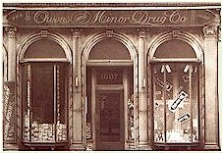
Rehost – Owens & Minor Avoid Costly ERP Replacement
Gap Analysis
Rehosting Solution
Partners – Perot Systems and Micro Focus
Preserves O&M business logic
$6M per year OpEx savings
Savings funds self-service B.I.
$ 9M Migration costs – 18 month ROI
Mainframe not flexible
Escalating annual operating costs for systems
Scarce capacity for technology R&D
Complicated ETL and data warehouse systems
10M lines of legacy COBOL
The original retail storefront of Owens & Minor Drug Company was opened in January 1882 in the business district of Richmond, VA.
Notes:
http://www.microsoft.com/casestudies/Microsoft-SQL-Server-2008-Enterprise/Owens-Minor/Medical-Supply-Distributor-Avoids-Costly-ERP-Replacement-with-Migration-to-Windows-Server-and-SQL-Server/4000006470

Slide 7
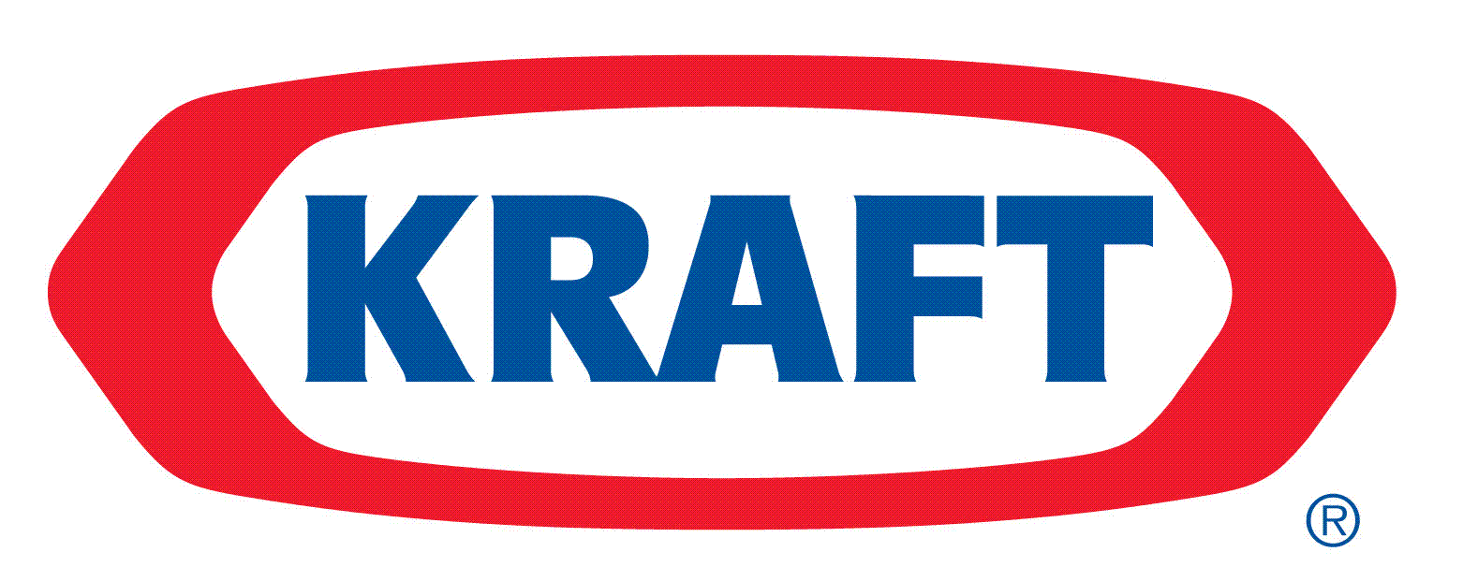

Rehost: Kraft Foods
Customer
Kraft Foods in Minneapolis eliminated 2 1600 MIPS Mainframes by rehosting to the Microsoft Platform.
Challenge
Implementing SAP – left many apps that didn’t have a roadmap on mainframe
Reduce IT costs
3,200 MIPS primarily CICS/COBOL/DB2
Key Benefits
Realized significant savings
Data is all in SQL – improved analytic capabilities – self-service BI
Positioned to move selective workloads to the cloud
Improved availability through clustering
Solution
Rehost to Microsoft platform
Maintained outsourcing HP ES (hosted old and new infrastructure)
Infosys migrated applications and data using Micro Focus

Slide 8

Rewrite – Case Study Gain Agility with the Microsoft Platform
Customer Business Challenge
Rewriting Solution
Need to transform to a broader set of products and services
Need to continually innovate the business model
A single platform for end to end
Microsoft® SQL Server® 2008 Enterprise Edition (64-bit)
Windows Server® 2008 Enterprise Edition (64-bit)
Microsoft Visual Studio®
Customer Technical Challenge
Rehost Solution
Current rigid application architecture
Multiple redundant policy applications
No extensible architecture for operational efficiency
Complete application roadmap
Select applications with less demand for business change
Use Cobol.Net for application compatibility with rewrite project
Notes:
FOR THE COMPLETE CASE STUDY, GO TO: WWW.MICROSOFT.COM/CASESTUDIES

Slide 9
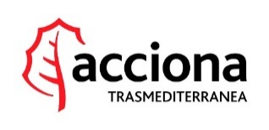
Rehost to Azure: Acciona Transmediterranea
Customer
Acciona Transmediterranea is a Spanish shipping line with 25 ships, 544 million euros yearly revenue, vessels sailed a total of 1,521,988 nautical miles and carried 3.3 million passengers, 78,146 vehicles and 5,877,351 and linear meters of cargo.
Challenge
Constrains on how they could support direct to consumer:
Ticketing system on mainframe
High-cost of system
Slow to respond to new requirements.
Key Benefits
Savings over $1M per year
Faster time to market
Ability to handle seasonality of business
Able to reach new markets
Information, people and processes integration
Improved B2B integration
Solution
Migrated COBOL code to Cloud using Micro Focus Visual COBOL
Migrated data to SQL Database and developed new front-end with VisualStudio.

Slide 10
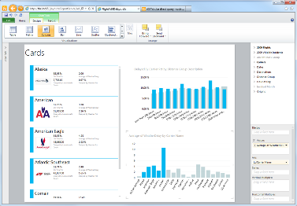
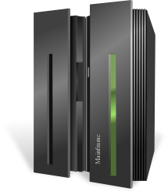

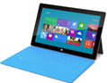
Approach for Migrating Mainframe
Migrate Data with SSIS and Partner Tools
1
2
Migrate applications
Leave as COBOL/JCL
Translate to .NET
3
Training
2
4
Translate / COBOL.NET
3
Train developers and operations
1
5
SSIS / ETL tools
Extend with Office, SharePoint
4
Enhance with Modern Apps
5
Mainframe
SQL Server Environment

Slide 11
Solution/Proof: Solution Details
Migrate mainframe code to Windows
Micro Focus VisualCobol
Fujitsu NetCOBOL
Raincode
Migrate data to SQL Server
Partner tools
SSIS – to SQL Server
Deploy emulation environment (on-line and batch)
Micro Focus Enterprise Server
GT Software Neo Suite
Solutions available for direct-to-Cloud migrations
Micro Focus
Fujitsu
Raincode
LZLabs
Code conversion
Several partner options for COBOL to C#, or .Net options (ex. Asysco, Averisource, Blueage)
Notes:
Contact the platform modernization team wwappm@Microsoft.com on assistance and help determine the appropriate solution/partner/approach

Slide 12
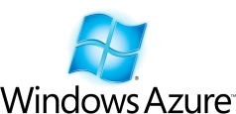
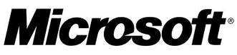
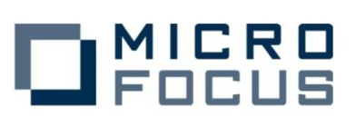
Micro Focus preferred target platforms are Windows and Azure
MF lead IDE framework is Visual Studio
MF lead testing platform is Windows Server
MF database to test against is SQL Server
MF leading Cloud implementation is on Azure
SQL Azure database support
Host Compatibility Option for SQL Azure (HCOSA) to minimize SQL changes when migrating
VSAM data stored within SQL Azure but accessed using existing CICS file I/O
Visual COBOL Modernization tooling available on Visual Studio
Support to Microsoft Management Console (MMC) administration, monitoring and control as well as integration with Microsoft SCOM management tools
Fixes, new features and new products all delivered on Windows earlier than all other platform
MF CICS is available for Azure
Notes:
Microsoft is injecting important resources into their “Taking share programs “where they aim at stealing Market share from the likes of IBM and Oracle.

Slide 13

Moving to Visual COBOL – Addressing Customer Issues
Visual COBOL
We need to deploy to the Cloud Azure
Industry standard IDE integrates all languages
We will need to deploy on Windows 10
Exploit industry standard UI technology
We have two different dev teams using two sets of different tools
Unify dev practices and skills under one IDE
I cannot modernize my user interface – no suitable technology exists
Deploy to the very latest OS releases
My COBOL apps,C#, and VB.NET apps can’t easily integrate
Deploy proven apps into Cloud and Azure
Net Express

Slide 14




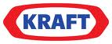



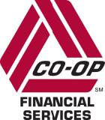







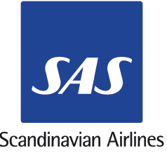





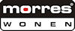

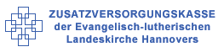

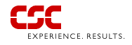
MF Windows Migration experience is built on leading customers across all industries around the world
VantageOne
CAPSIL

Slide 15
Microsoft Based Engagements
Central States Health and Life Company (USA)
Financial Network Services (Australia)
PPG (USA)
Quebec Loisirs (Canada)
Solcorp (Canada)
Sompo Insurance (Japan)
St. Louis PSRS (USA)
Tulane University (USA)
Western Australia DoIR (Australia)
Alnova (Spain)
Alcan (Germany)
Axfood (Sweden)
Bern Swiss Bertelsmann (Switzerland)
Bertelsmann Media (Poland)
Donauland Bertelsmann (Austria)
Eurocopter an EADS company (Germany)
France Loisirs Suisse (Switzerland)
Hannover Re (UK)
ICS ComptenceCentre (Austria)
LR-Medienverlag Cottbus (Germany)
Royal Borough of Windsor Maidenhead (UK)
Southern Life (RSA)
St. Helens Borough (UK)
UNILOG (Germany)
Winterthur (Austria)
NYSE Arca (USA)
Notes:
Some of our key customers, who have all achieved significant business benefits through working with Micro Focus. Whether organizations are looking to dramatically reduce costs, improve time to market of new products or services, increase developer productivity or improve software development efficiency, Micro Focus can help you.
We can cover more of these customers later in the presentation, but here are a few key benefits that we have seen customers achieve:
Morres Wonen: reduced costs by 60% (application migration)
The Brick: increased revenue by 5% through more efficient credit applications (user interface improvement)
HCL: reduced costs by 75% (application migration of pension system)
City of Miami: reduced costs by 50% and improved response times (application migration of fire dispatch system)
CSC: increased developer productivity by 25% (offloading development to Windows)
SAS: increased revenue per customer through faster access to business intelligence (application migration)
15

Slide 16
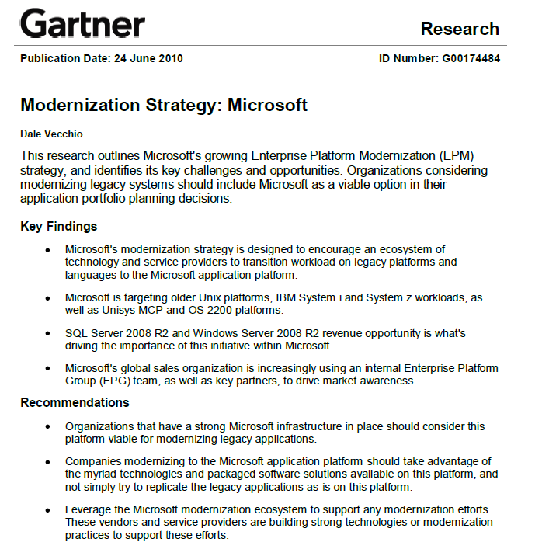
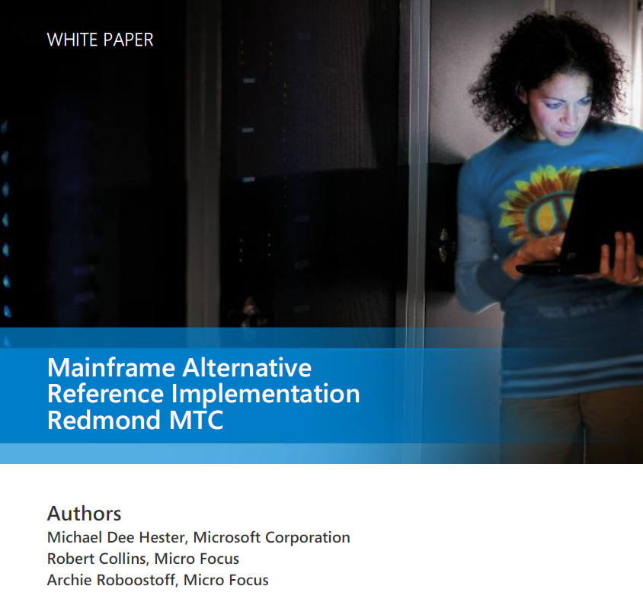
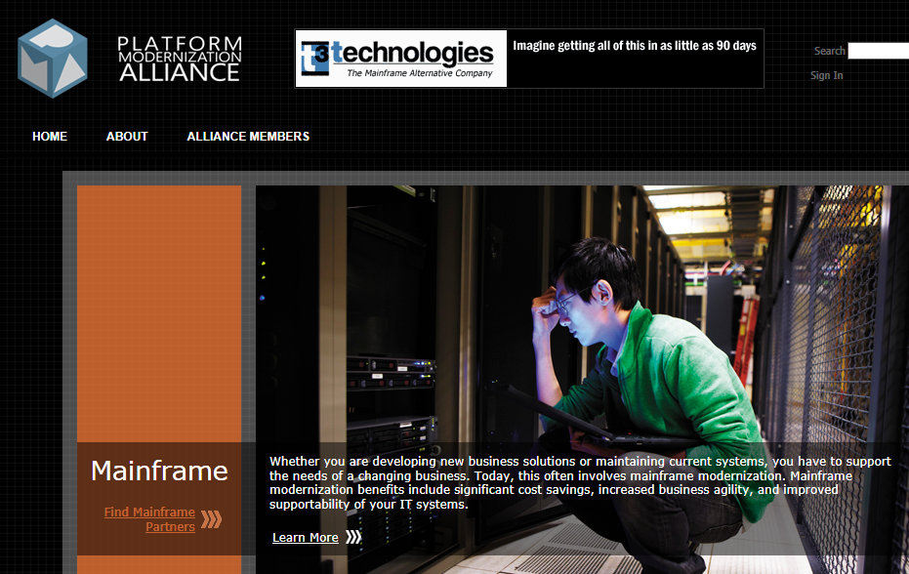

Mainframe Alternative / Mission Critical ….
Mainframe
2009 – Micro Focus & Microsoft Tech. Dev. Alliance
2011 – Reference Architecture
2012 – Capacity Planning / Benchmark with HP
Results: DL980 with 80 core*~200 MIP per core = 16K MIPS
6 months to build/run and presented to Gartner 5/17
Mainframe Alternative “Mileage”
These estimates reflect MIPS/Core from MFA z/OS Reference application sizing study
Batch
170
MPC
Your actual mileage will vary depending on how you drive and maintain your application.
MPC = MIPS/Core
MPC rating based on 2 CPU core system running at 75% busy
CICS
288
MPC
Expected MPC range will vary based on number of CPUs used. For each CPU added, total system performance will increase, but incremental MPC will decline. The above numbers represent the maximum number of CPUs per Server.
Estimated 3 year Savings
$4,000,000+ (based on typical 1,000 MIPS mainframe TCO)
HP – Microsoft - Micro Focus

Slide 17
Self-funding Mainframe Modernization projects
From Mainframe Sizing study
$11.6M
Savings
Benefits beyond cost savings:
Better OLTP performance
Faster Batch performance
Better cost per transaction
More transactions per Kwatt
Equivalent MIPS capacity (~6,286 MIPS)
Source: Mainframe Sizing study done by: HP, Microsoft and Micro Focus.
Notes:
z10 Model 709
6,286 MIPS
804 MSU’s
DL980
6,687 MIPS (zRef)
40% utilization
DL980 includes Microsoft Windows Server , Windows SQL, Micro Focus Enterprise Server software)
Z10 model 709 includes: includes z/OS, CICS, DB2, COBOL
The results disproved several common mainframe myths:
• Myth #1 – A mainframe is better at running simultaneous workload (e.g., CICS and batch). Reality – In all cases, the HP MFA systems tested showed higher capacity than the mainframe, even while running CICS and batch at the same time.
• Myth #2 – Mainframe is superior at running batch. Reality – The HP MFA platforms finished batch jobs much faster than the mainframe.
• Myth #3 – Only a mainframe can run at 100% sustained system utilization. Reality – The results showed MFA systems running near 100% utilization for sustained periods, not just bursts of 100% utilization.

Slide 19
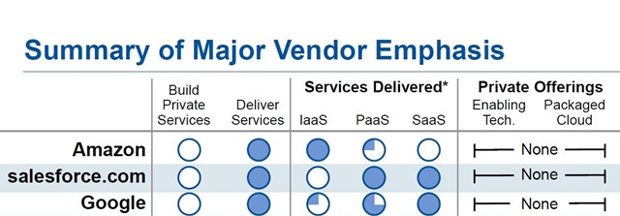
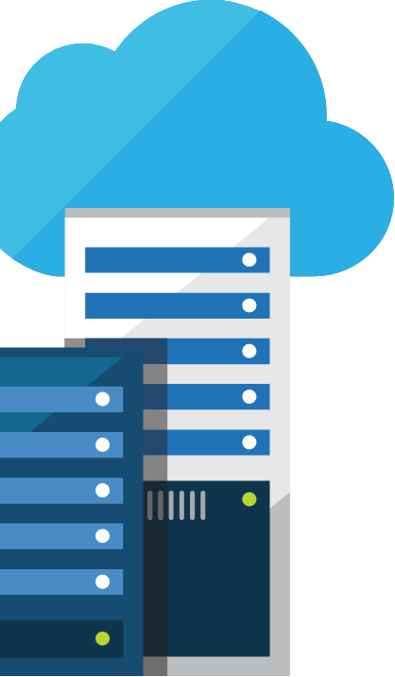
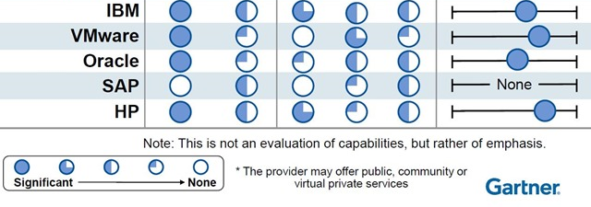
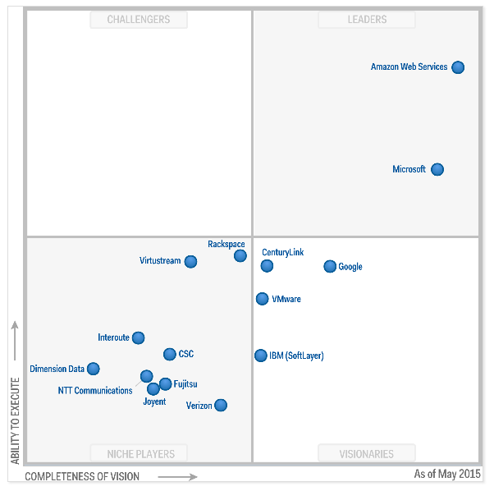
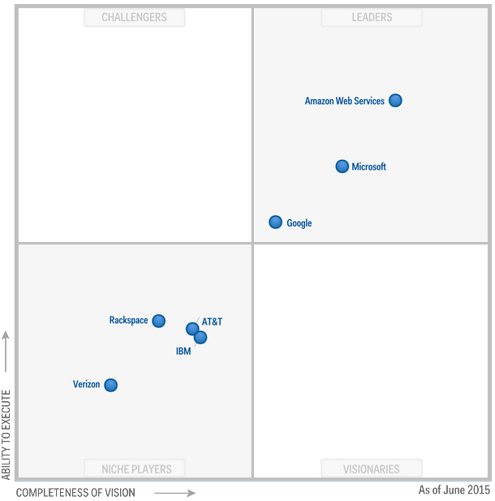
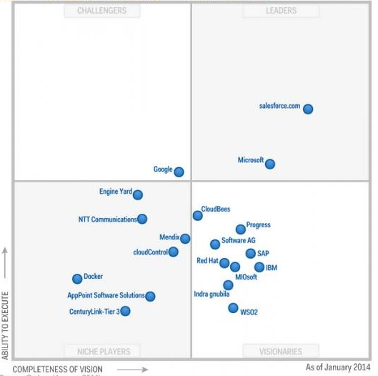
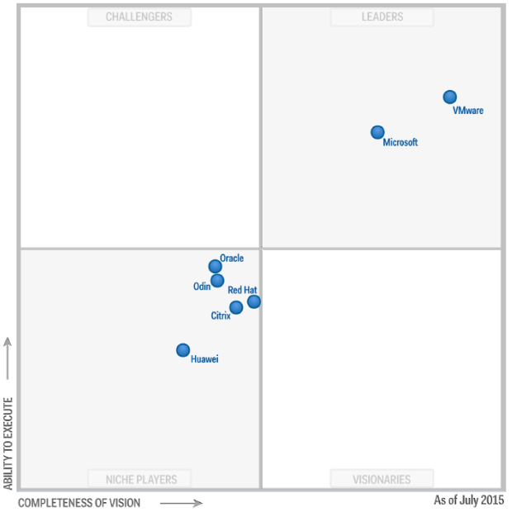
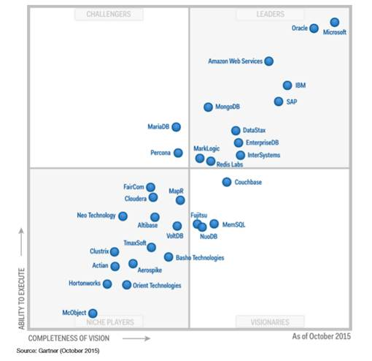
Industry validation
"Microsoft’s comprehensive hybrid story, which spans applications and platforms as well as infrastructure, is highly attractive to many companies, drawing them towards the cloud in general.”
LYDIA LEONG, Gartner
Microsoft Leads Everywhere…
Public Cloud IaaS (May 2015)
Cloud Storage (June 2015)
Enterprise App PaaS (Jan 2014)
X86 Server Virt (July 2015)
Operational DBMS Systems (Oct 2015)
Microsoft
Microsoft
Microsoft
Microsoft
Microsoft

Slide 20
Mainframe to Azure Workloads: Before & After
Mainframe
Azure
Apps /
Apps /
COBOL
PL/I
COBOL
Assembler
Natural
Transaction Manager
Transaction Manager
PL/I
CICS
IMS
3rd party TPM
Sys Mgmt / Tools
Batch
Batch
Sys Mgmt / Tools
Print/output Mgmt
(CA-SAR, SPOOL)
JES / JCL
Print/output Mgmt
(SSRS/ LRS)
JCL
Scheduling
(TWS-OPC)
Scheduling
(AZ Sched./Tivoli)
Security
(RACF)
Data
Data
Security
(AD)
IMS/ VSAM/ SEQ
DB2/ Adabas
SQL
IMS/ VSAM/ SEQ
Monitoring
Monitoring
z/OS or zLinux
Red Hat, SUSE, Windows Server

Slide 21
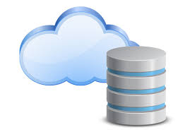
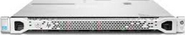
Mainframe migration: possible deployment view between Primary and DR site
Primary Azure Site
Backup/DR Azure Site
Storage Replication
Azure Storage
Production
App
Azure Storage
Backup / DR
Application
Application
HA
sync
Database
Database
HA
Utilities (Sys Mgmt)
Sys Mgmt
HA
Test / QA / Pre-Production
App High Availability Cluster
Transaction Monitor
Batch
Scheduler
Print
MQ
LDAP
Application
HA
Azure VM Tier
Database
HA
Production
App | G-Series
DB | G-Series
Utilities | A-Series
Pre-Production
App | Dv2-Series
DB | Dv2-Series
Utilities | A-Series
Development
App | A-Series
DB | A-Series
Utilities | A-Series
Utilities (Sys Mgmt /Monitor)
HA
Database Highly Availability
Development
System Management
App + DB

Slide 22
Mainframe on Azure Estimates (5,000 MIPS)
Workload | Azure Type | VM# & Type | Estimated Monthly Cost
DB | G5 (32 cores) | 1 – Primary VM 1 – HA VM 1 – BU/DR VM | $19,396
Apps | G4 (16 cores) | 1 – Primary VM 1 – HA VM 1 – BU/DR VM | $10,892
Utilities | A7 (8 cores) | 1 – Primary VM 1 – HA VM 1 – BU/DR VM | $2,232
DB | D14 v2 (16 cores) | 1 – Primary VM 1 – HA VM | $2,205
Apps | D14 v2 (16 cores) | 1 – Primary VM 1 – HA VM | $2,205
Utilities | A7 (8 cores) | 1 – Primary VM 1 – HA VM | $1,488
Development # 1 | A6 (4 cores) | 2 – Primary VM | $248
Development # 2 | A7 (8 cores) | 2 – Primary VM | $496
Development # 3 | A11 (16 cores) | 3 – Primary VM | $1,161
Primary Storage | P30 (SSD-Page Blob & Disk) | 20- 1TB SSD | $2,703
Virtual Tape | HDD – Page Blob & Disk | 20 – 1TB HDD | $1,384
 |  | Support | $1,000
 |  | Monthly Cost | $45,410
 |  | Annual Cost | $545,925
Production
Compare vs. Mainframe
Pre-Prod.
Dev.
Stor.
* Includes hardware and OS estimate only. Does not include: system software or people costs.
*All Azure VM’s are Active
*Does not include data egress costs
*Production 7/24, test/staging 7/8

